Slide 1
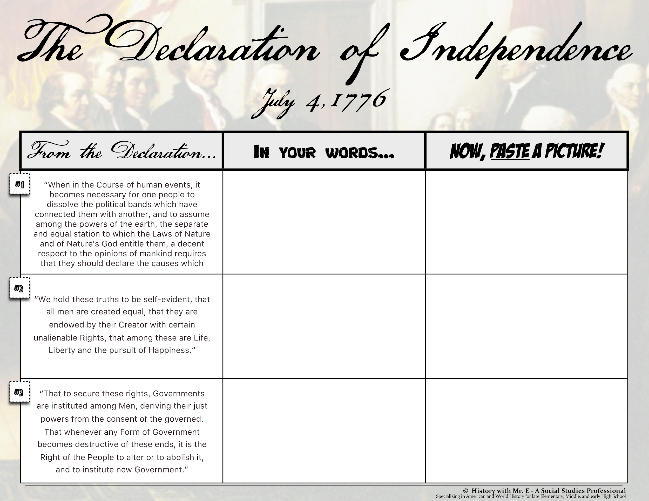
*Go to: insert image, then choose “search.” Search for an image on Google that represents the words!

Slide 2
